Slide 1

Car Rental System
Team 3 - Vaccine C19 1. Vo Huy Bao Nguyen - 611532 2. Thanh Nam Nguyen - 611259 3. Dinh Nhan Vo - 611526

Slide 2
Agenda
Problem statement
Use case diagram
Use cases details
Class diagram
Implementation

Slide 3
Problem Statement
The purpose is to build a car rental system that users (customers) can login to rent a car, and the owner, also an administrator, can use to add new cars to the collection, create new users, and print reports, such as how much a car rental system gets by one month,..
Most cars may be rented for 7 days, and for any damage inspected, the user will be fined 1000$ per one. If return date exceeds due date, user will be fined 50$ per day. The user will be shown the renting money right after they return the car. ONE user is only accepted to rent ONE car at the same time.
All users of the system are assigned a unique user id. First and last names, address (street, city, state, zip) and phone number of every user are also stored as user data. Cars have attributes, such as a model name, year, color, number of seats, license plate, availability.
The system will keep a record of his/her checkout activities in a checkout record history. A checkout record consists of a collection of the car, pickup date, return date, the user and the due date. The checkout record for a car rental is, therefore, a complete record of every car that the user has ever checked out.
In order to access the system, a user or administrator must login. Administrators can add/edit user info and add cars to the collection, but they are not allowed to checkout car for a user (unless they also have user access). Users can check out cars but are not allowed to add/edit users or add cars (unless they also have Administrator access).

Slide 4
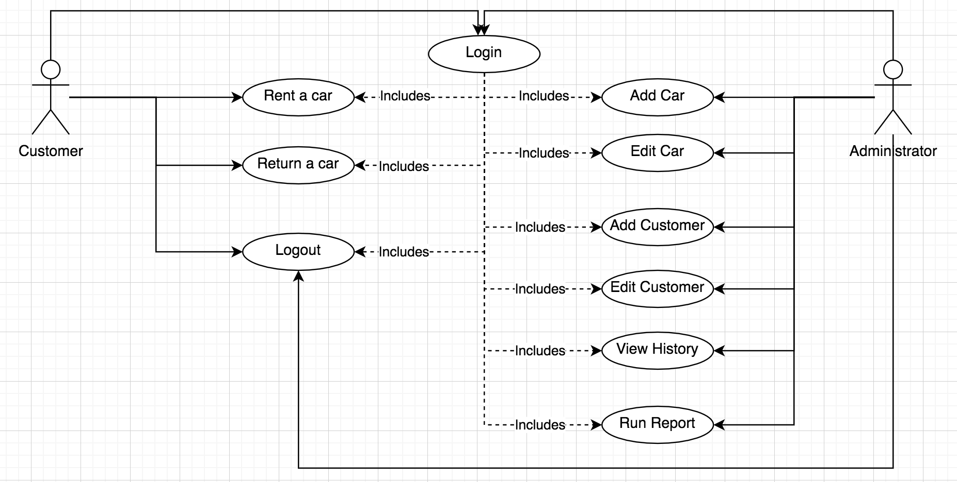
Use case diagram

Slide 5
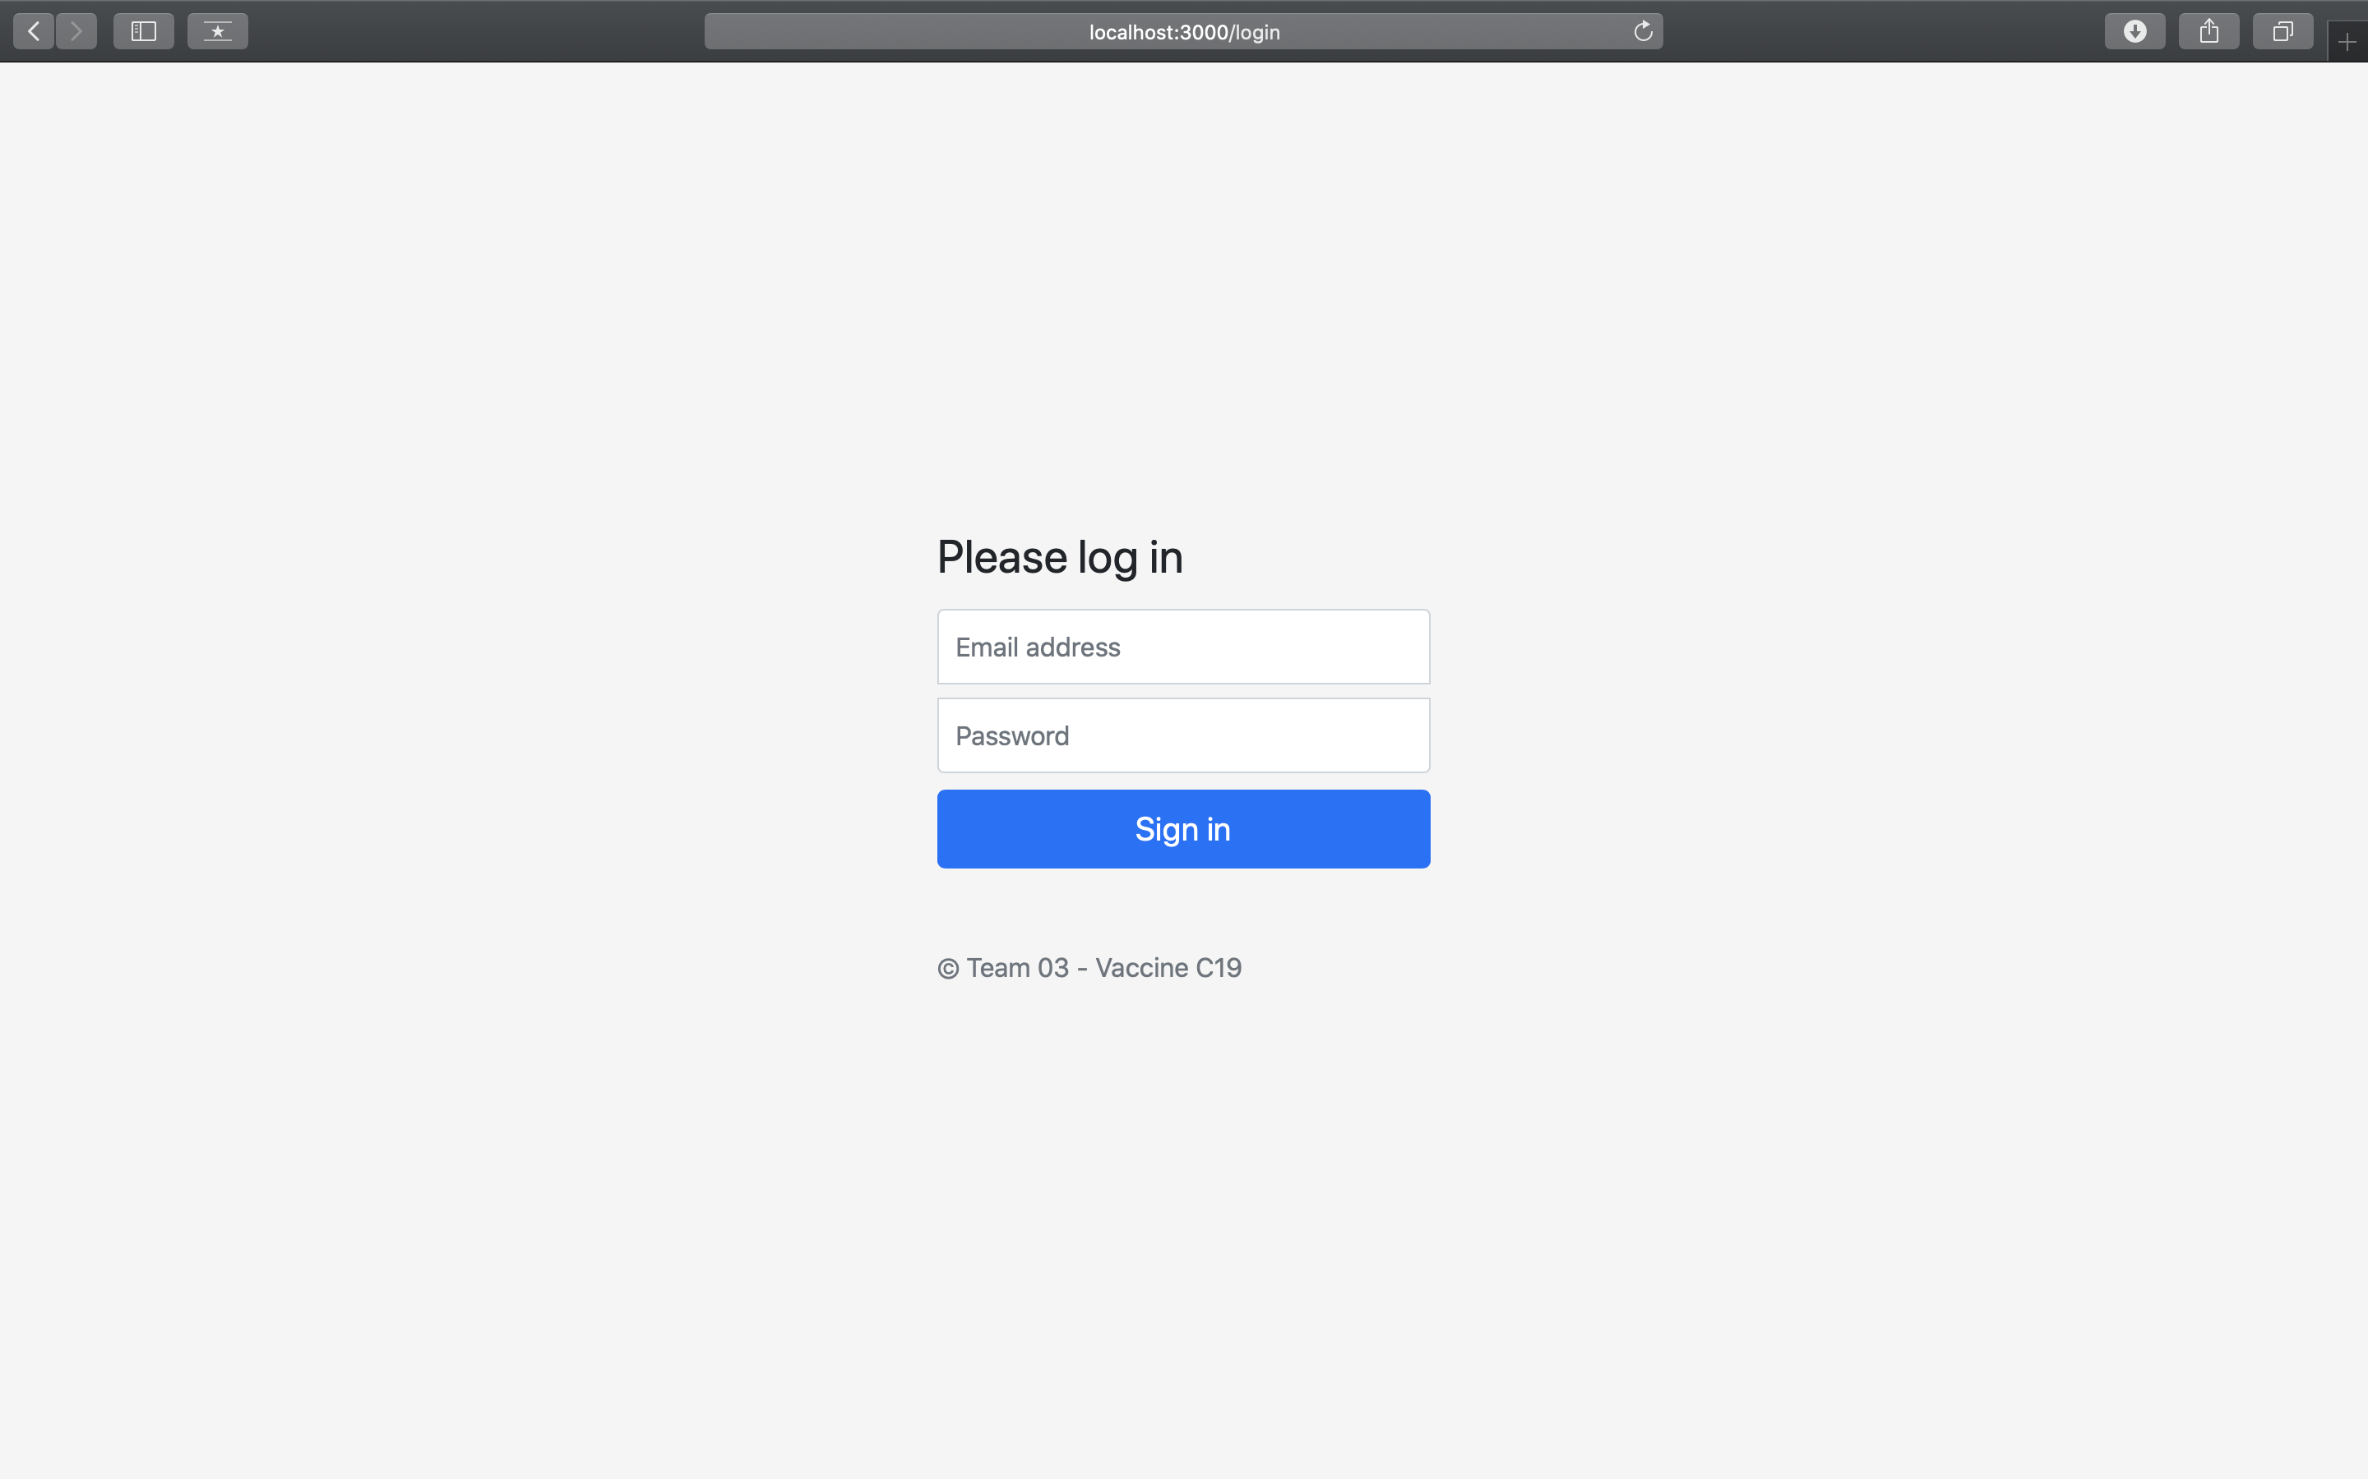
Use case - Login
Actor: Administrator / Customer
Description: User see a login form which allows him to be authentication in Rental car system. The login form requires two input info "username" & "password"

Slide 6
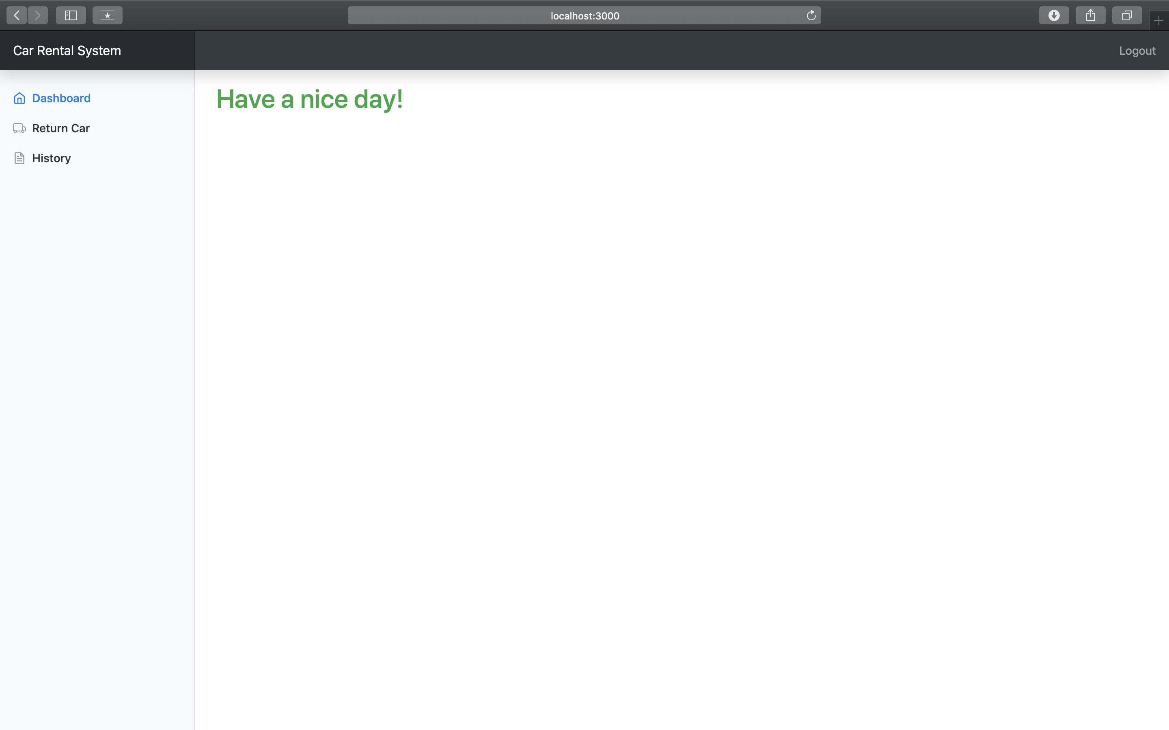
Use case - Logout
Actor: Administrator / Customer
Description: User can logout of the system. There is a "Logout" link in the header at right corner.

Slide 7
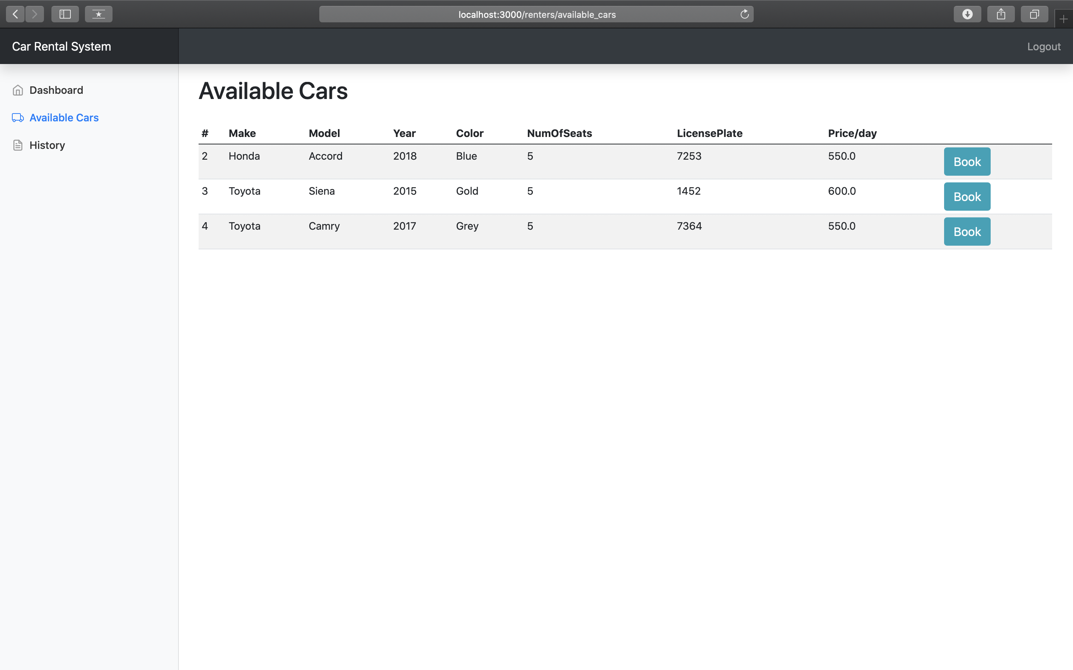
Use case – Rent Car
Actor: Customer
Pre-conditions: Logged user & no exist a booking not returned yet.
Description: User see a list of available cars in the system. User can click on "Book" button to go to screen which requires input "number of booking days".

Slide 8
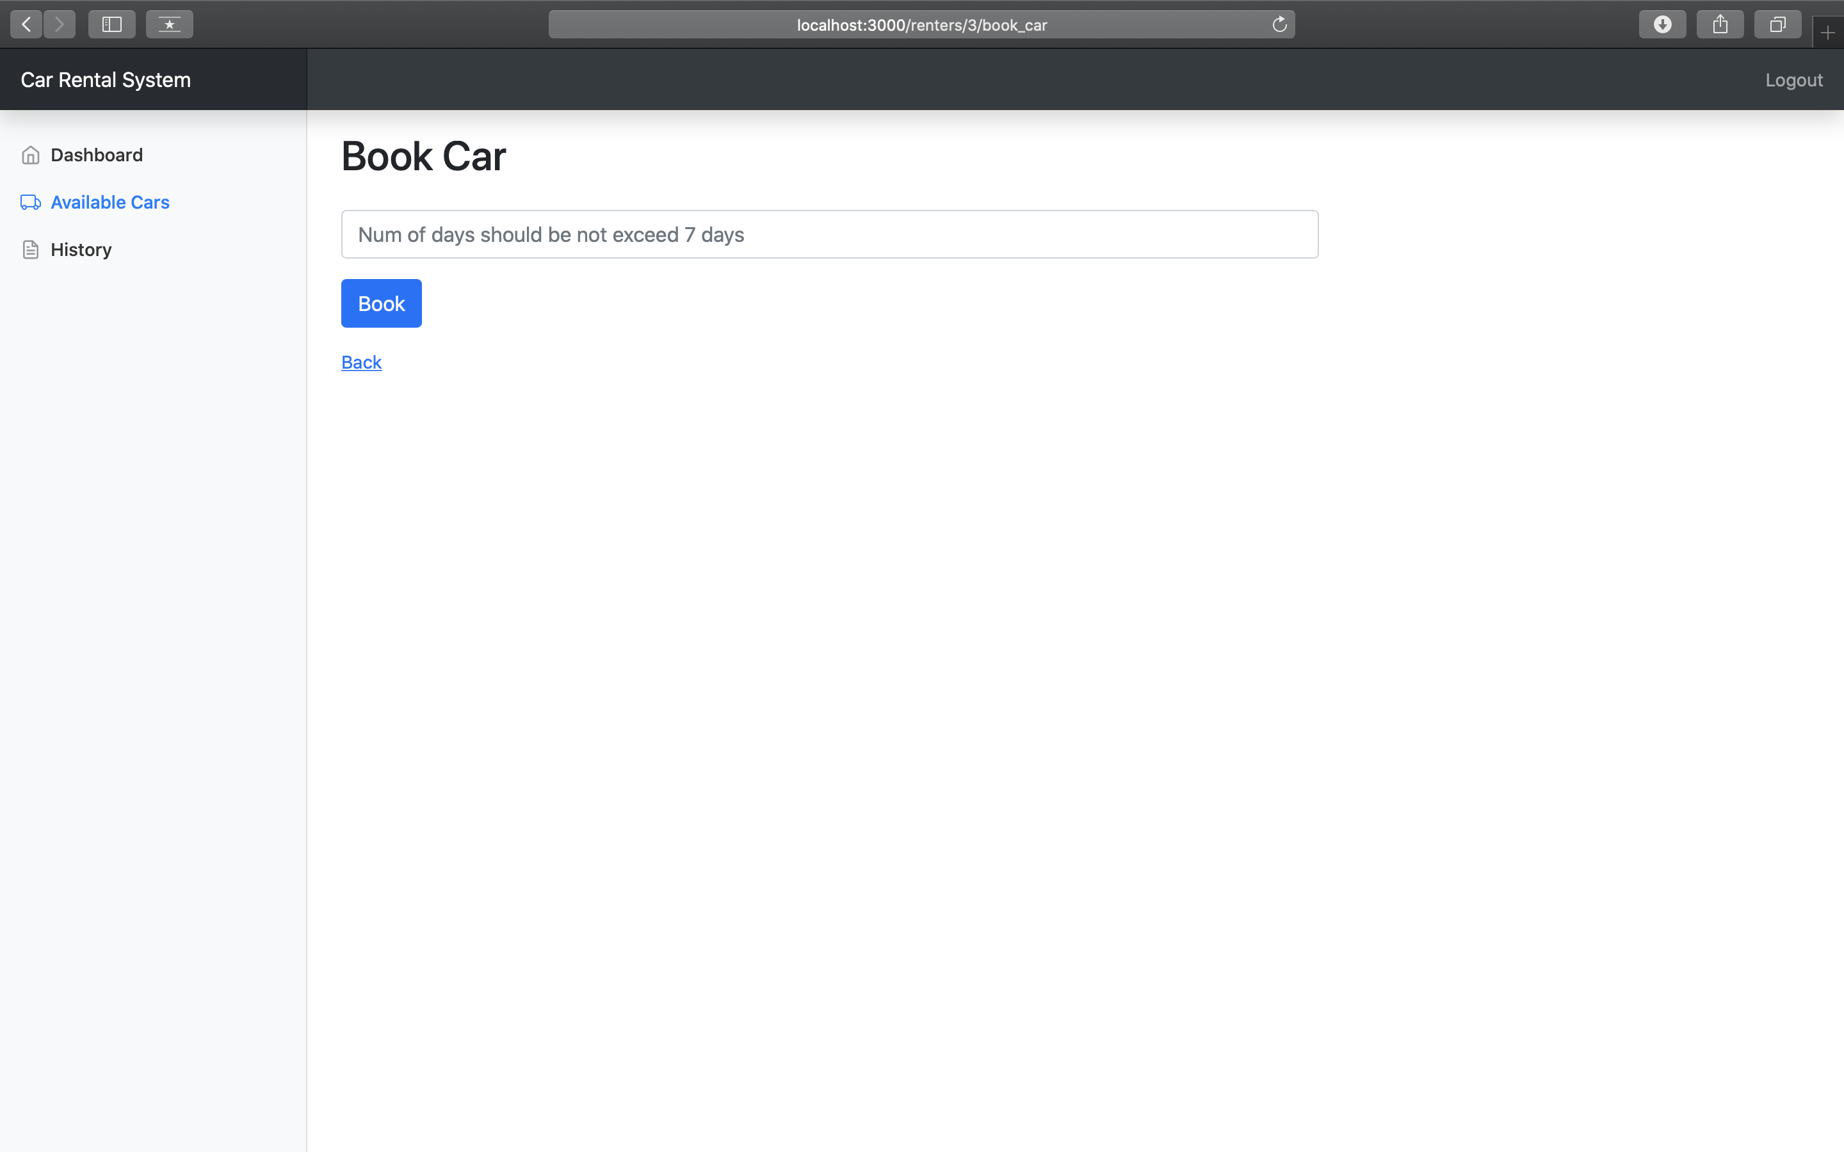
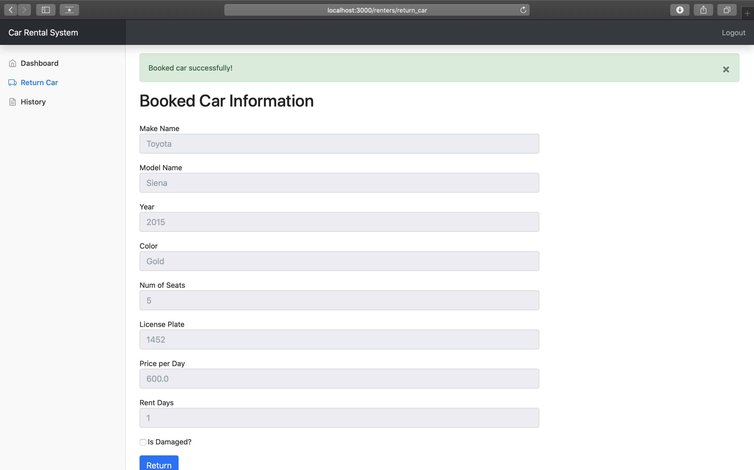
Use case – Rent Car

Slide 9
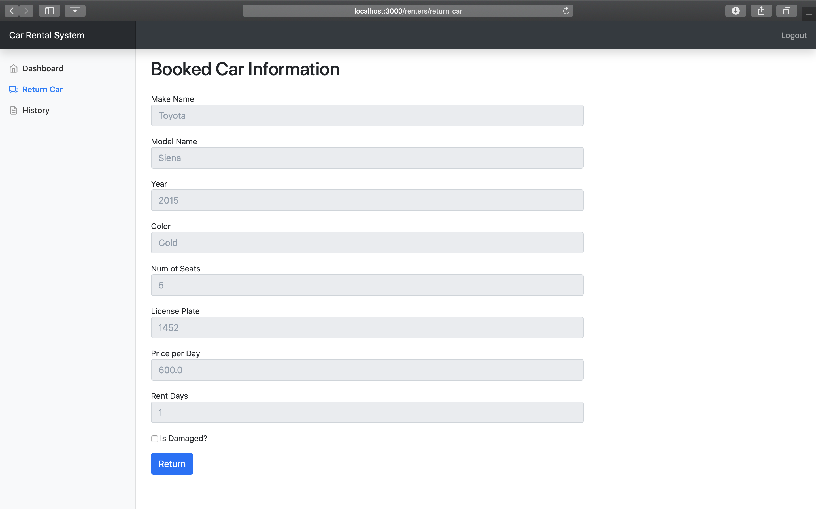
Use case – Return Car
Actor: Customer
Pre-conditions: Logged user & has a booked car.
Description: User sees his current rented car. There is a "Return" button which allows user to return his rented car.

Slide 10
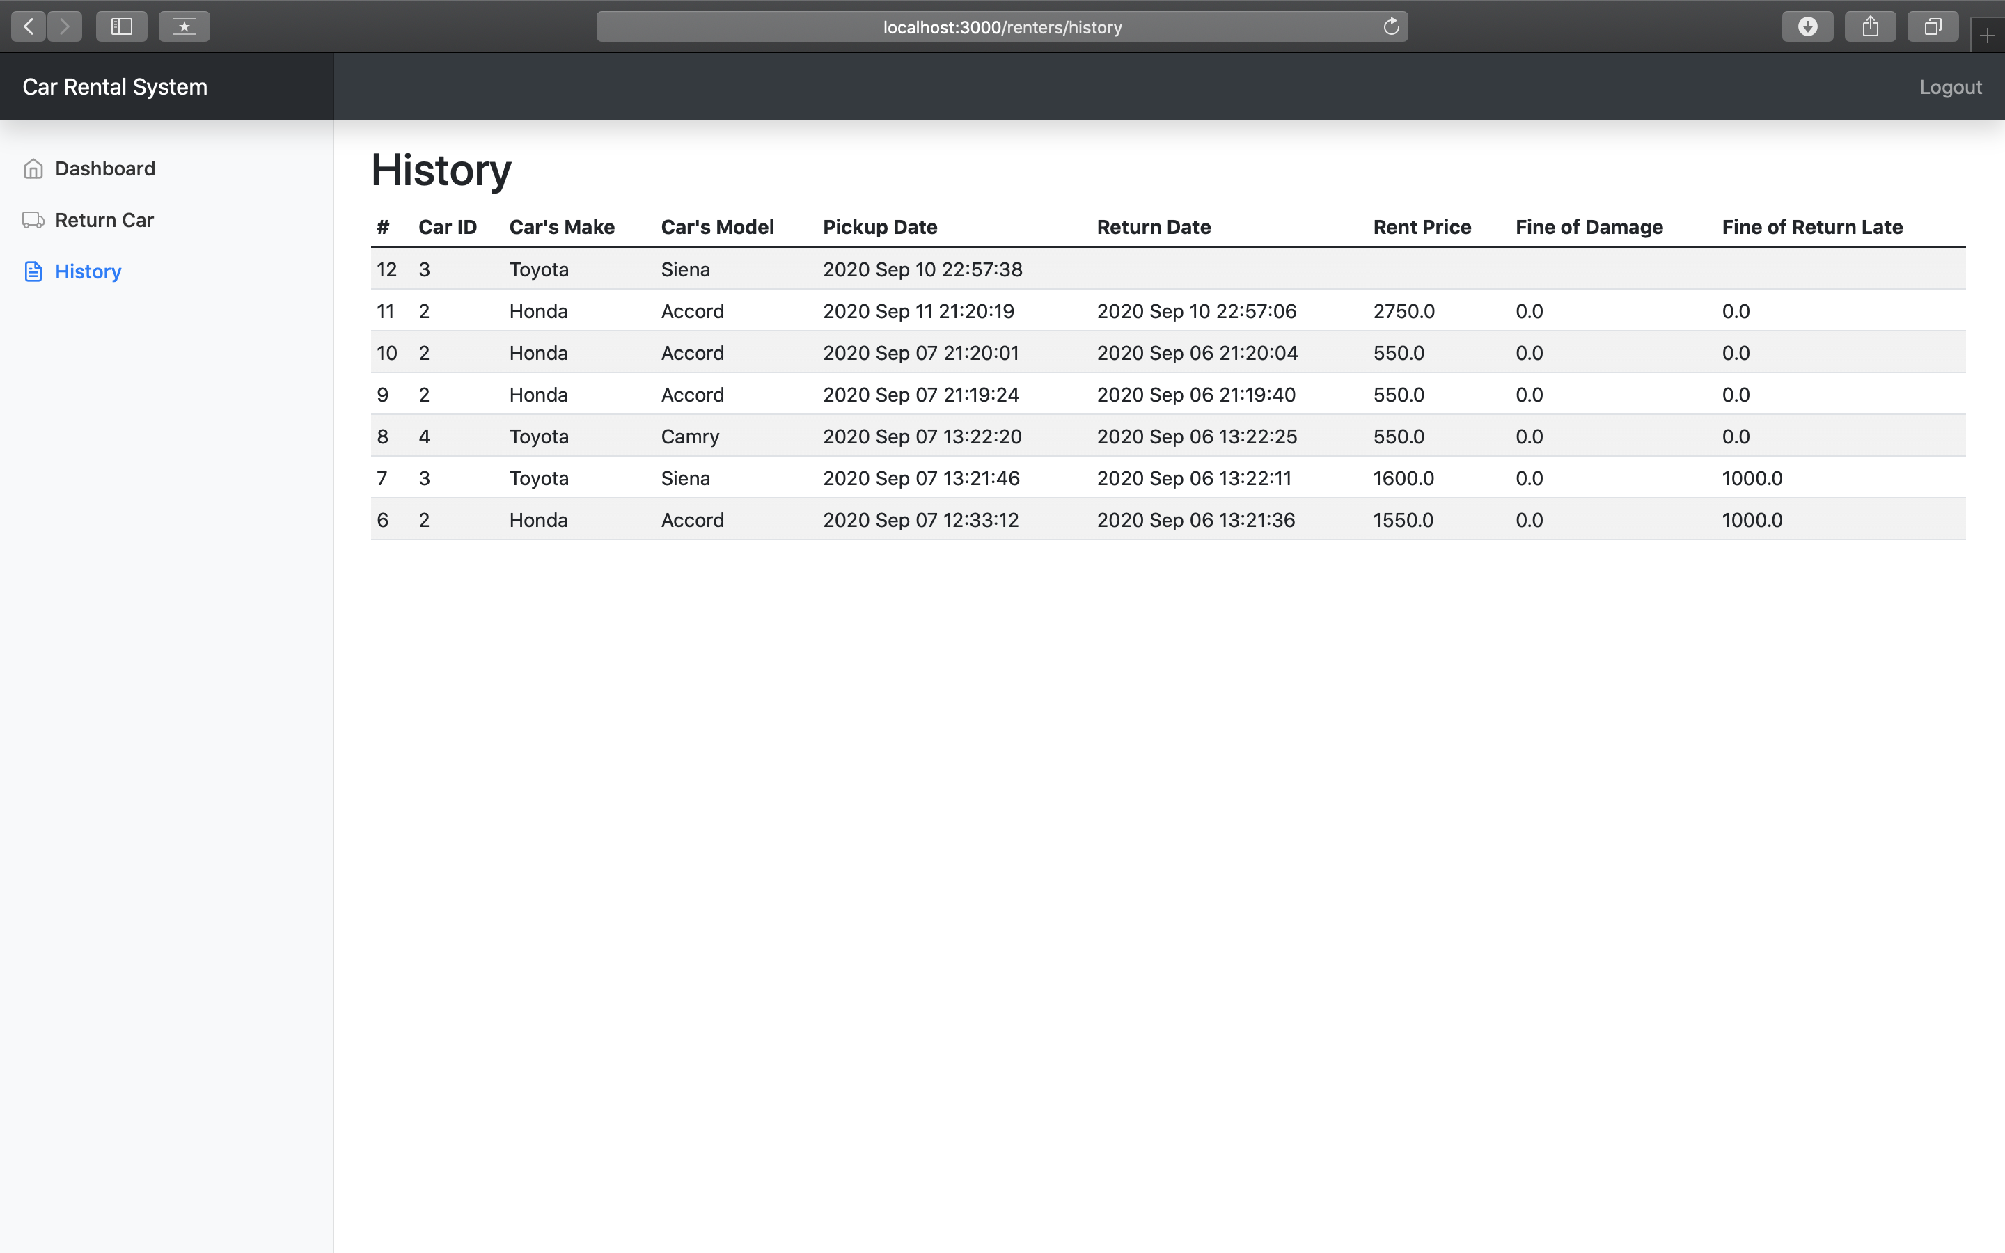
Use case – History Renting Cars
Actor: Customer
Pre-conditions: Logged user
Description: User can see a history of his renting (including current booking).

Slide 11
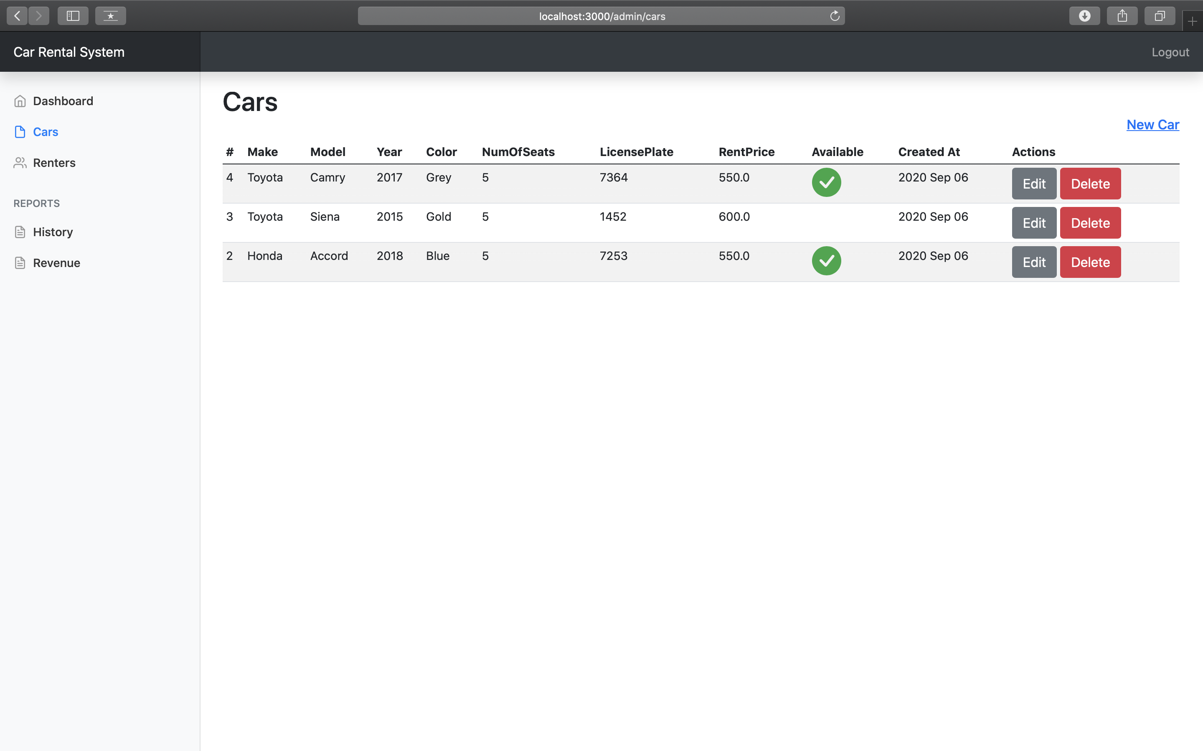
Use case – Add/Edit Car
Actor: Administrator
Pre-conditions: Logged user
Description: User clicks to "Cars" link in the navigation. Then, he can see a list of all cars in the system. From the list, he can add/edit/delete a car in the system.

Slide 12
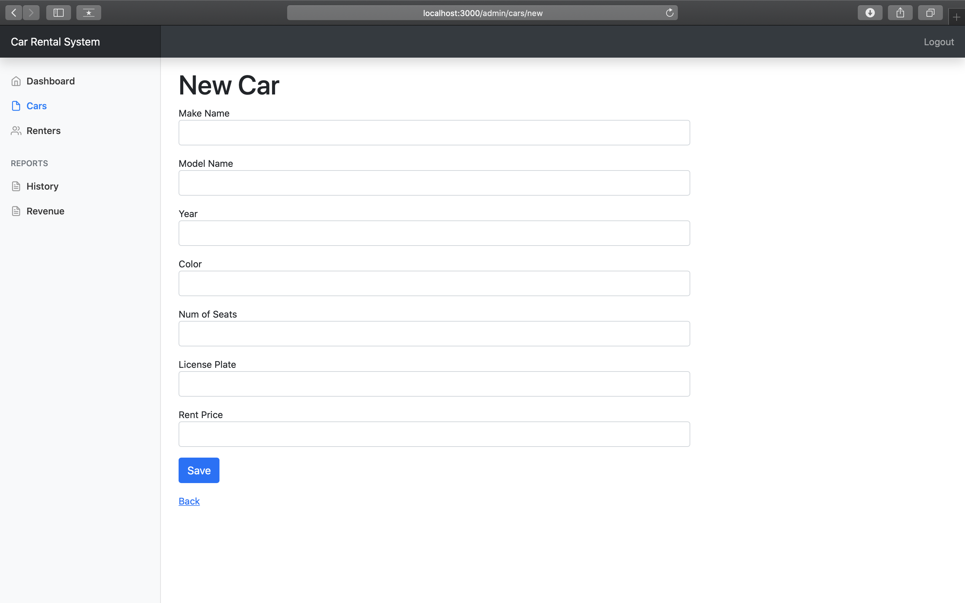
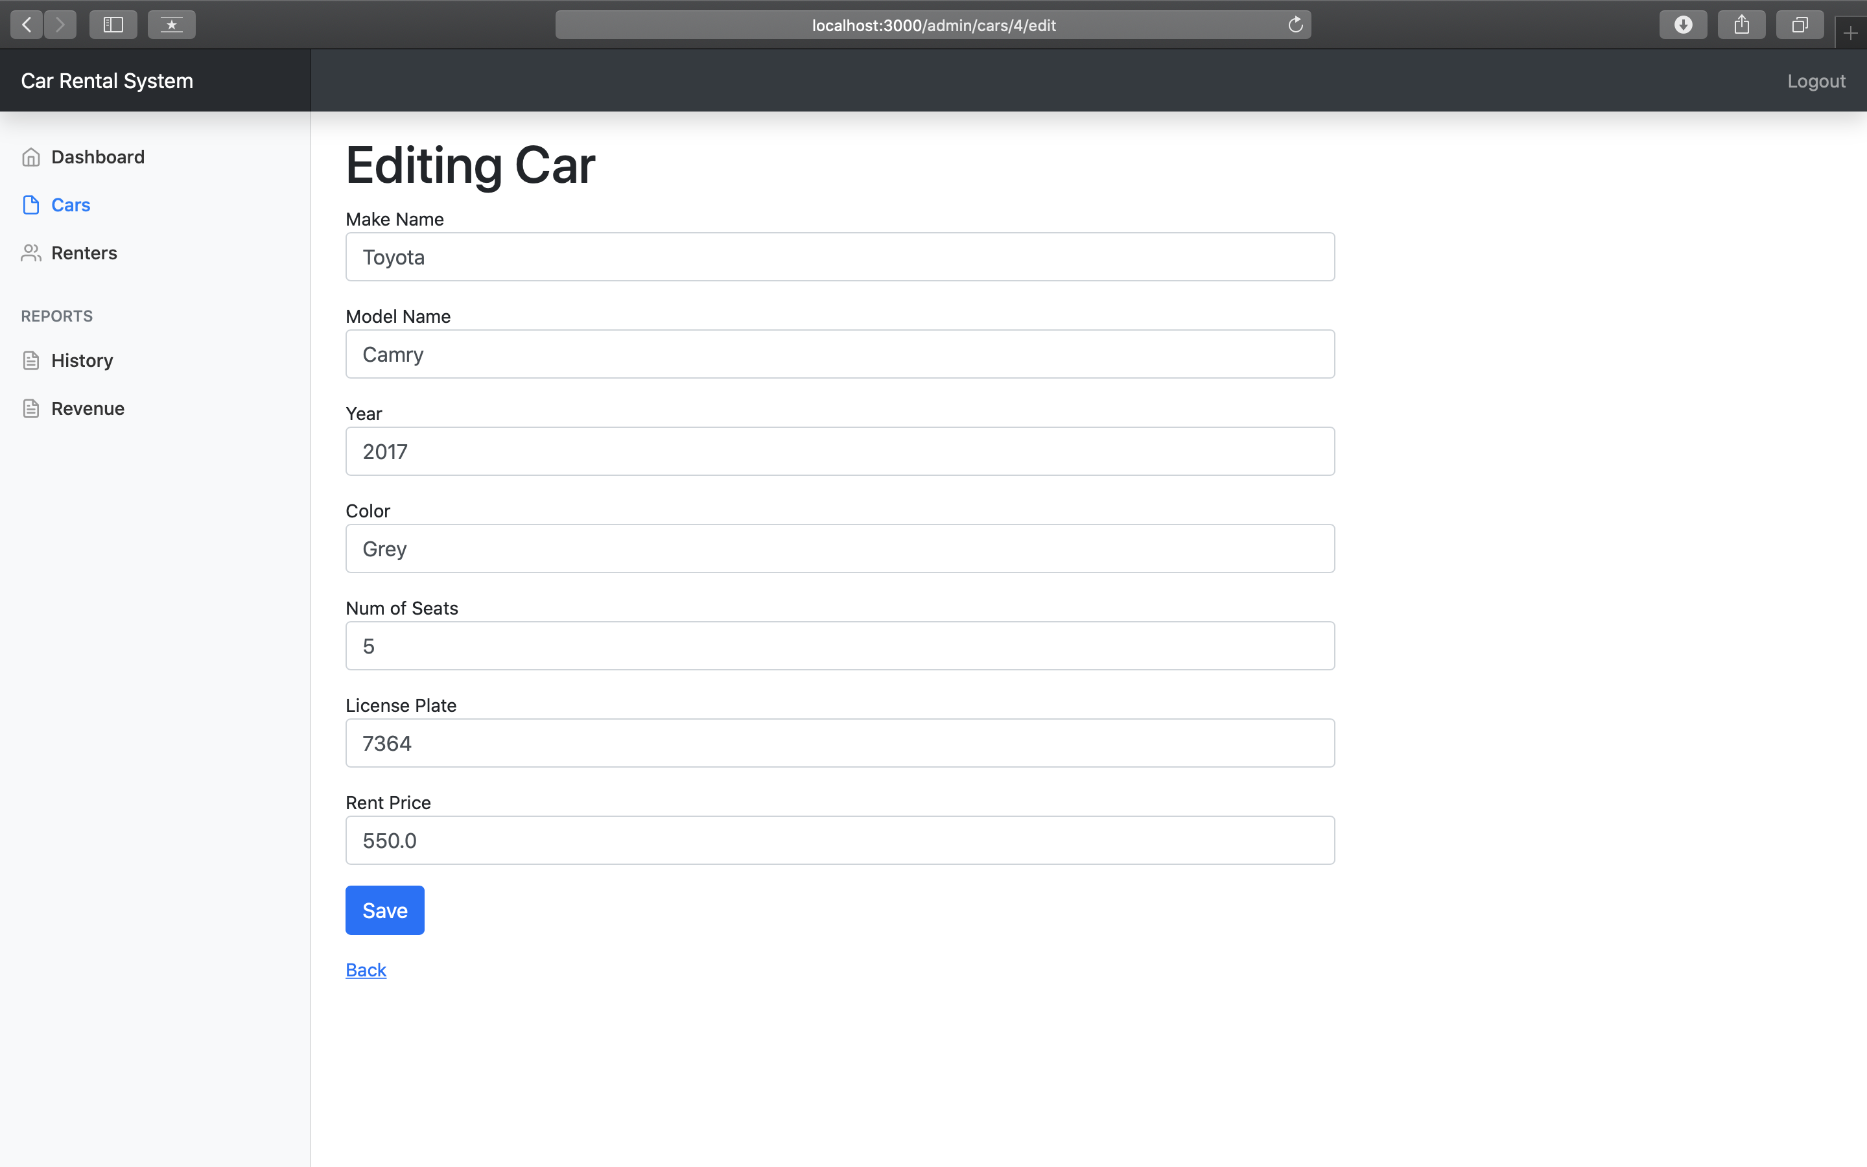
Use case – Add/Edit Car

Slide 13
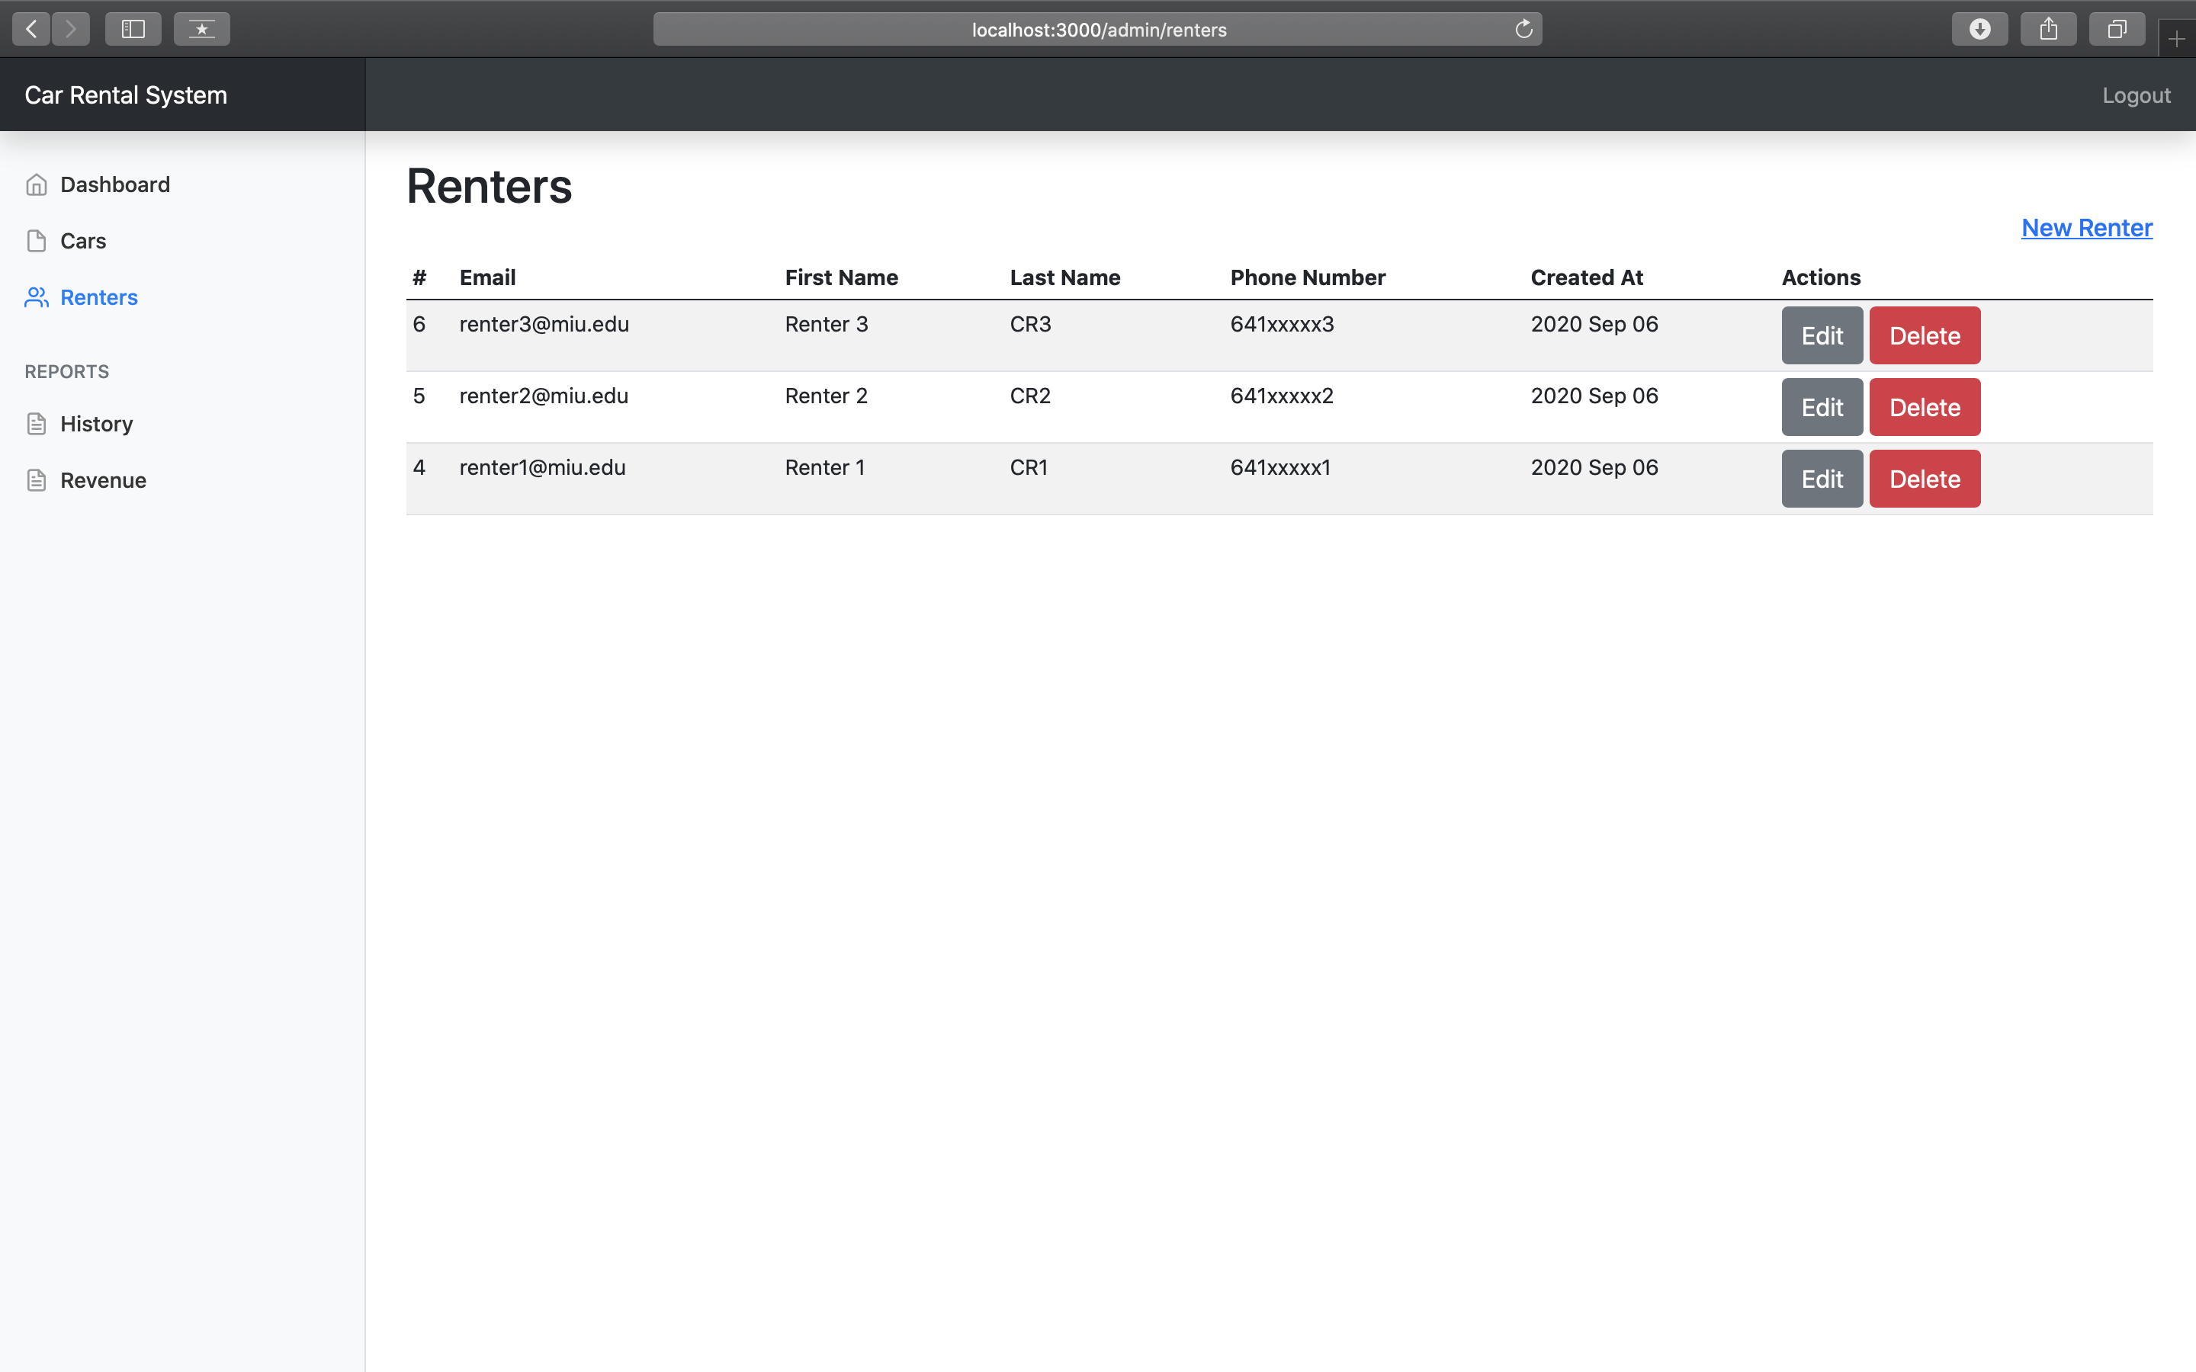
Use case – Add/Edit Customer
Actor: Administrator
Pre-conditions: Logged user
Description: User clicks to "Renters" link in the navigation. Then, he can see a list of all renters in the system. From the list, he can add/edit/delete a renter in the system.

Slide 14
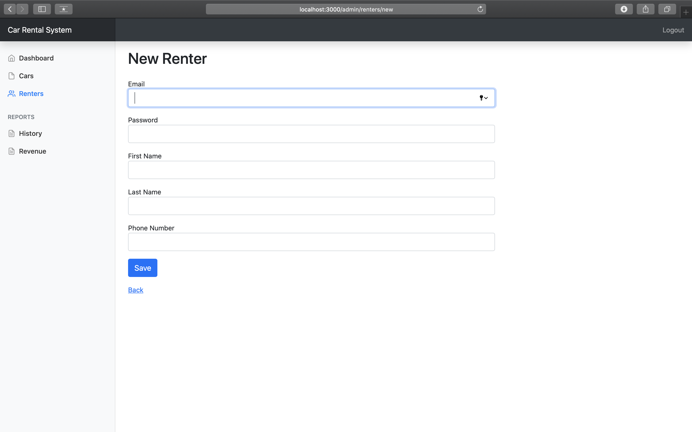
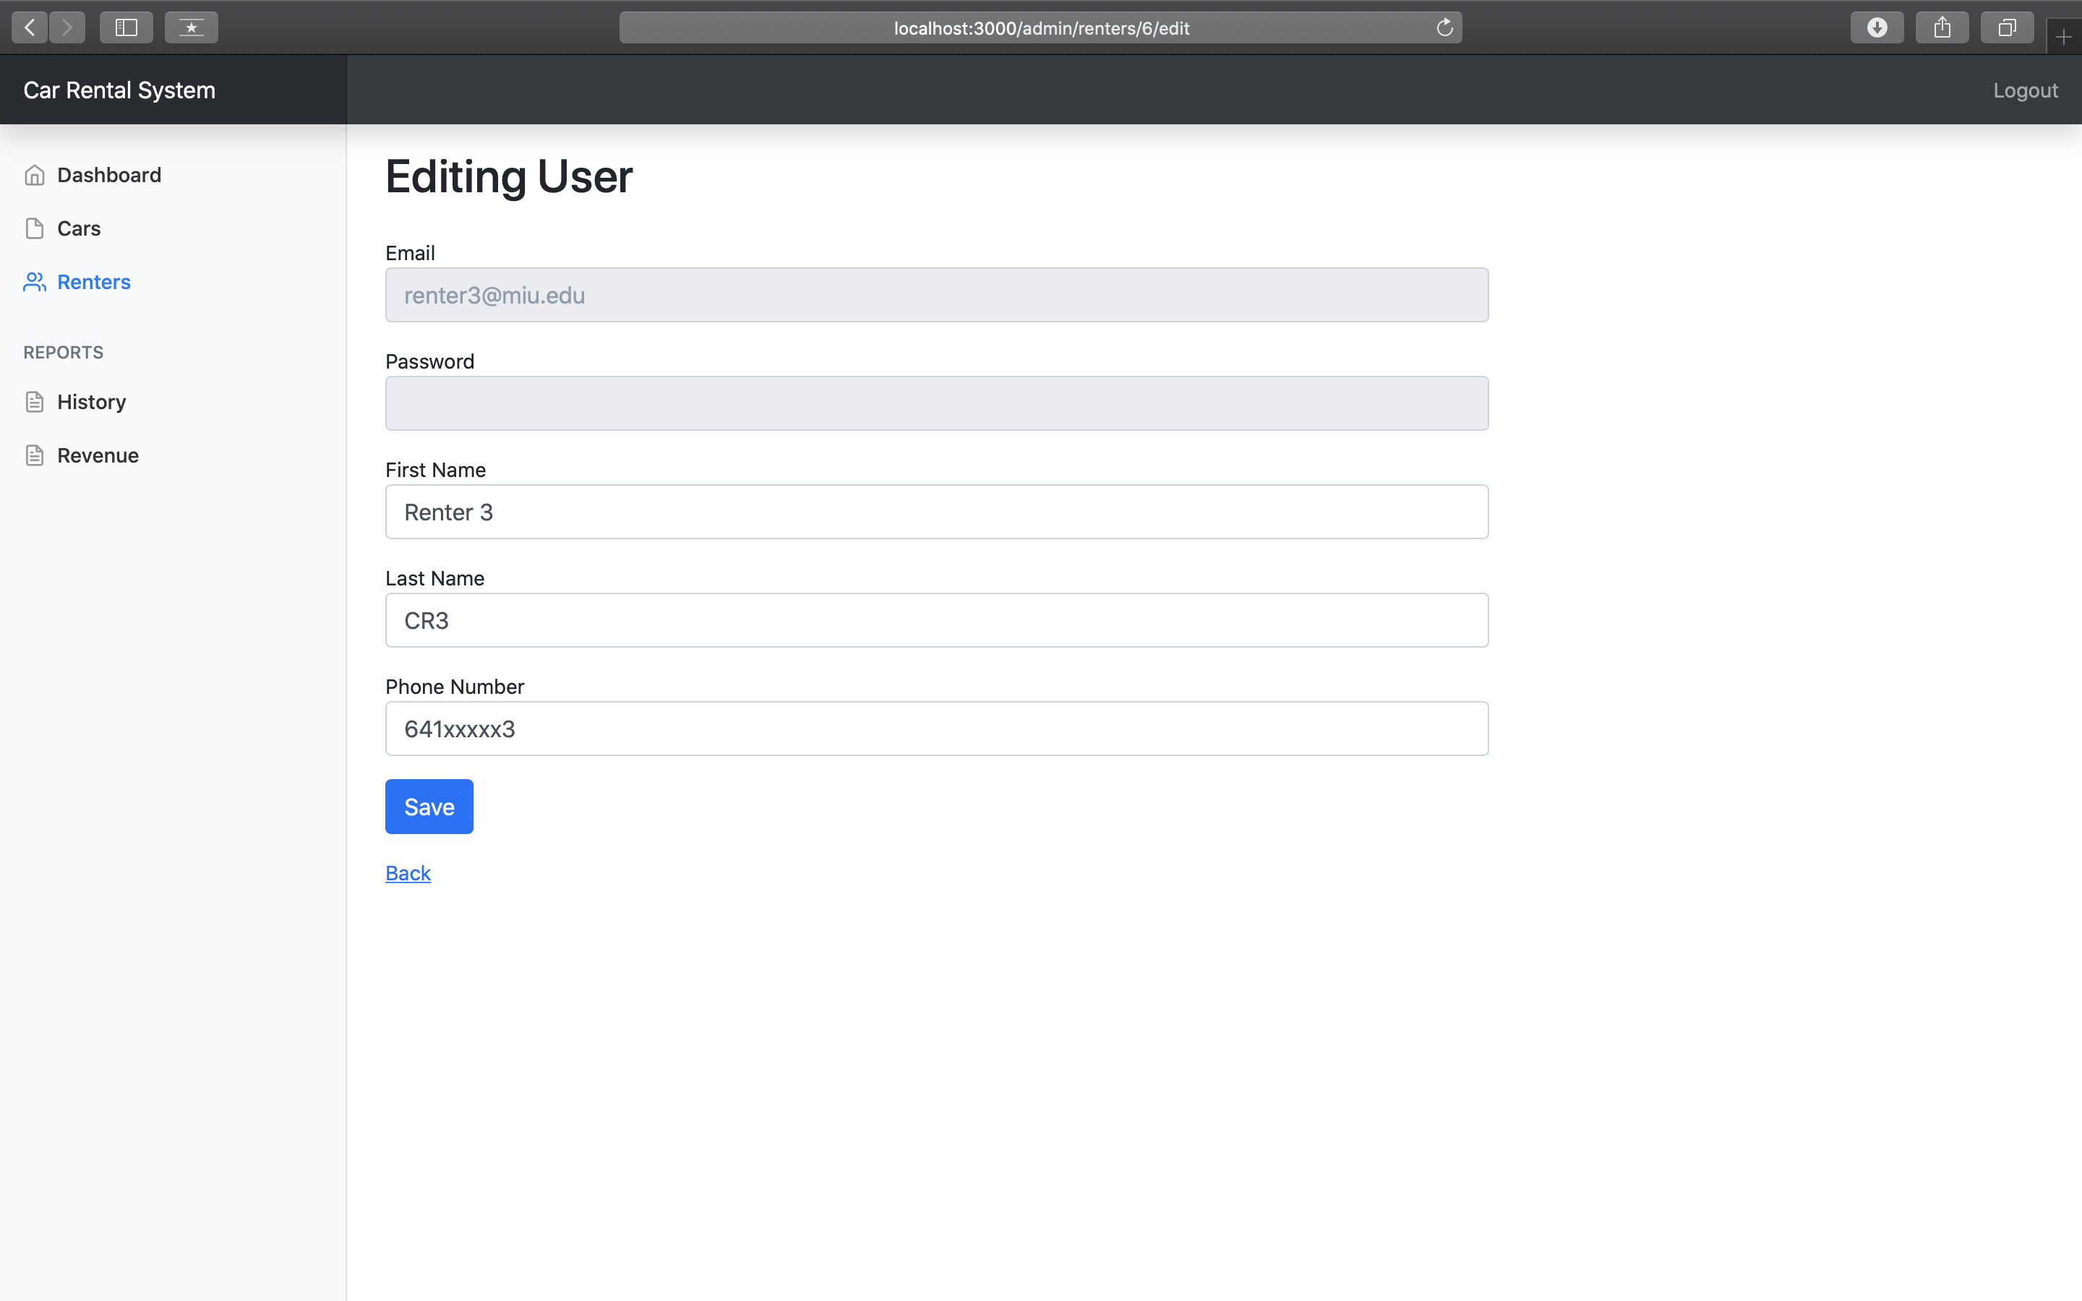
Use case – Add/Edit Customer

Slide 15
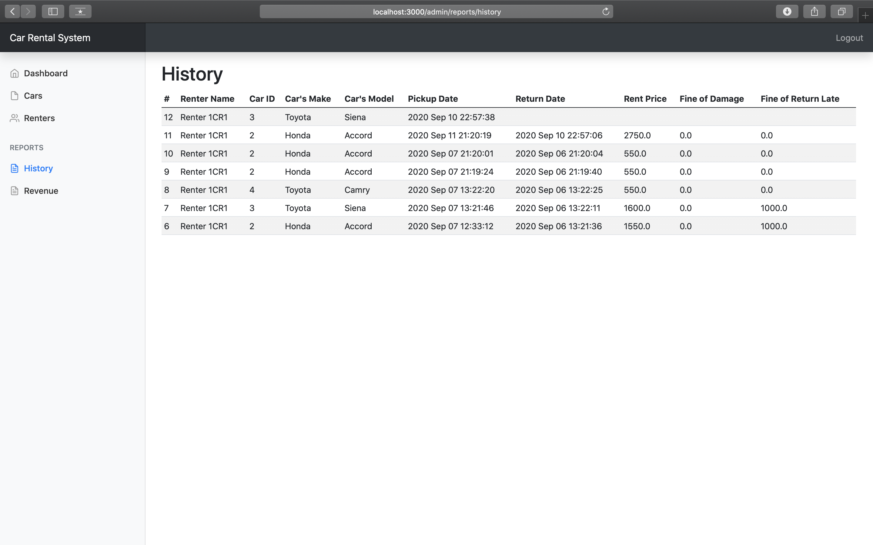
Use case – View History
Actors: Administrator
Description: User can see a history of his renting (including current booking).

Slide 16
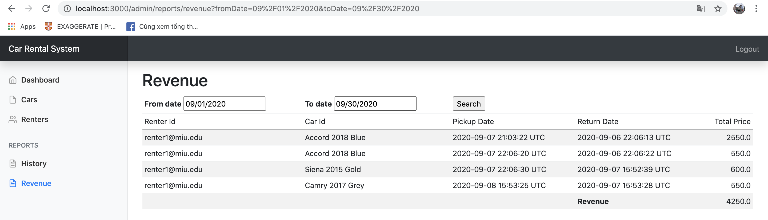
Use case – View Revenue
Actors: Administrator
Description: User can look for revenue in a period time.

Slide 17
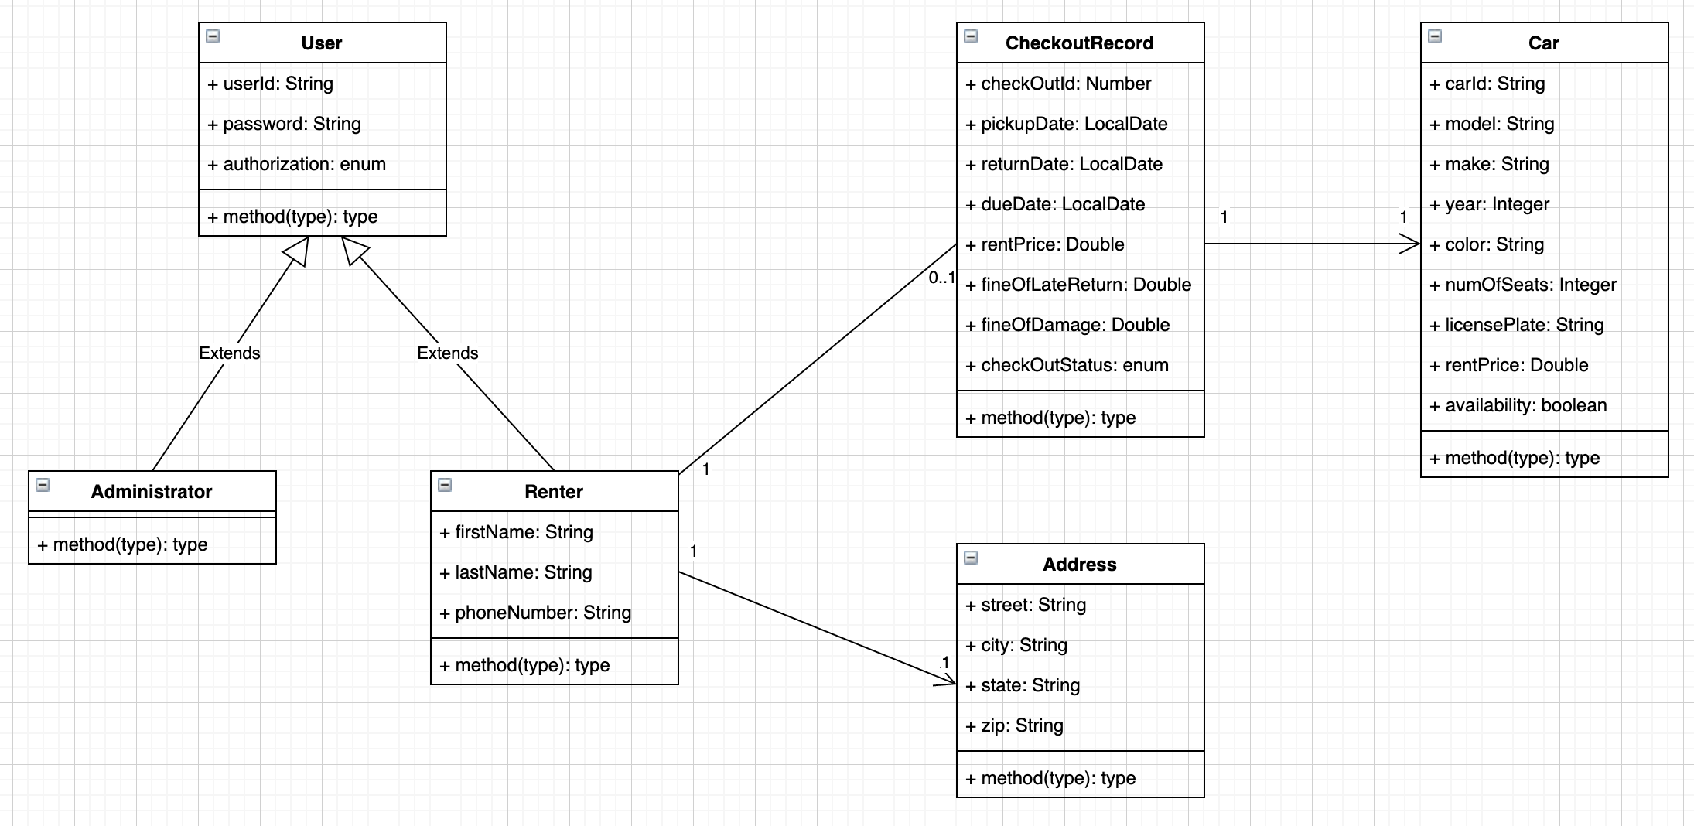
Class diagram

Slide 18
Implementation
Git source https://github.com/niick7/CarRentalSystem
Technology: Ruby on Rails, sqllite3
Demo UIs are all screenshots presented in this slide.
Other references: https://gorails.com/setup/osx/10.15-catalina

Slide 19


